Slide 1
Analyzing Species Distribution and Conservation Status in the Most Visited U.S. National Parks
Het Patel
Gözde Durgut
David Acevedo Cardona
Sree Paada Reddy

Slide 2
Dataset Collection and Description
Key Variables
ParkName: National park where the species was recorded.
CategoryName: Species category (e.g., Mammal, Bird).
SciName: Scientific name of the species.
CommonNames: Common names used for the species.
Order, Family: Taxonomic classification details.
TEStatus: Threatened/Endangered status.
Observations: Number of recorded sightings.
The U.S. Department of the Interior collects wildlife data through various methods including direct observation, field surveys, camera traps, acoustic monitoring, citizen science programs, and aerial photography.
Data Creation Date: September 19, 2013, last update in 2024
Dataset Dimensions 61,119 rows and 28 columns (variables)

Slide 3
Dataset Selection and Justification
Why We Chose This Dataset
Diverse Data Types for Analysis
Contains nominal, ordinal, categorical, and numerical variables.
Supports varied data visualizations to uncover trends and patterns.
Comprehensive Species Classification
Includes key taxonomy details:
Category, Order, Family, Scientific Name
Allows for biodiversity exploration across U.S. National Parks.
Focus on Endangered Species
We aim to analyze species' conservation status and distribution.
Key variables for this analysis:
TEStatus (Threatened/Endangered Status)
StateStatus, GRank, SRank

Slide 4
Q1. How do global conservation ranks vary across 15 most visited US national parks? (park name, G_ranks, species count)
Steps:
To investigate how species are distributed across national parks by conservation statues, we utilized a combination of spatial and categorical visualizations.
Stacked Bar Chart: We created a Stacked Bar Chart for each national park such that the length of each individual bars showcase the number of species within that national park. The stacks in a particular bar details the proportions of different conservation statuses based on the GRank.
We also try to show the null values within each park separately using an image of the park by blackening an area of the image based on the number of null values present within that park. The main reason for doing this was because without the null values, most of the species in all the parks looked secured, so we tried to highlight this missing data to showcase the unknown status of many species within the park.

Slide 5
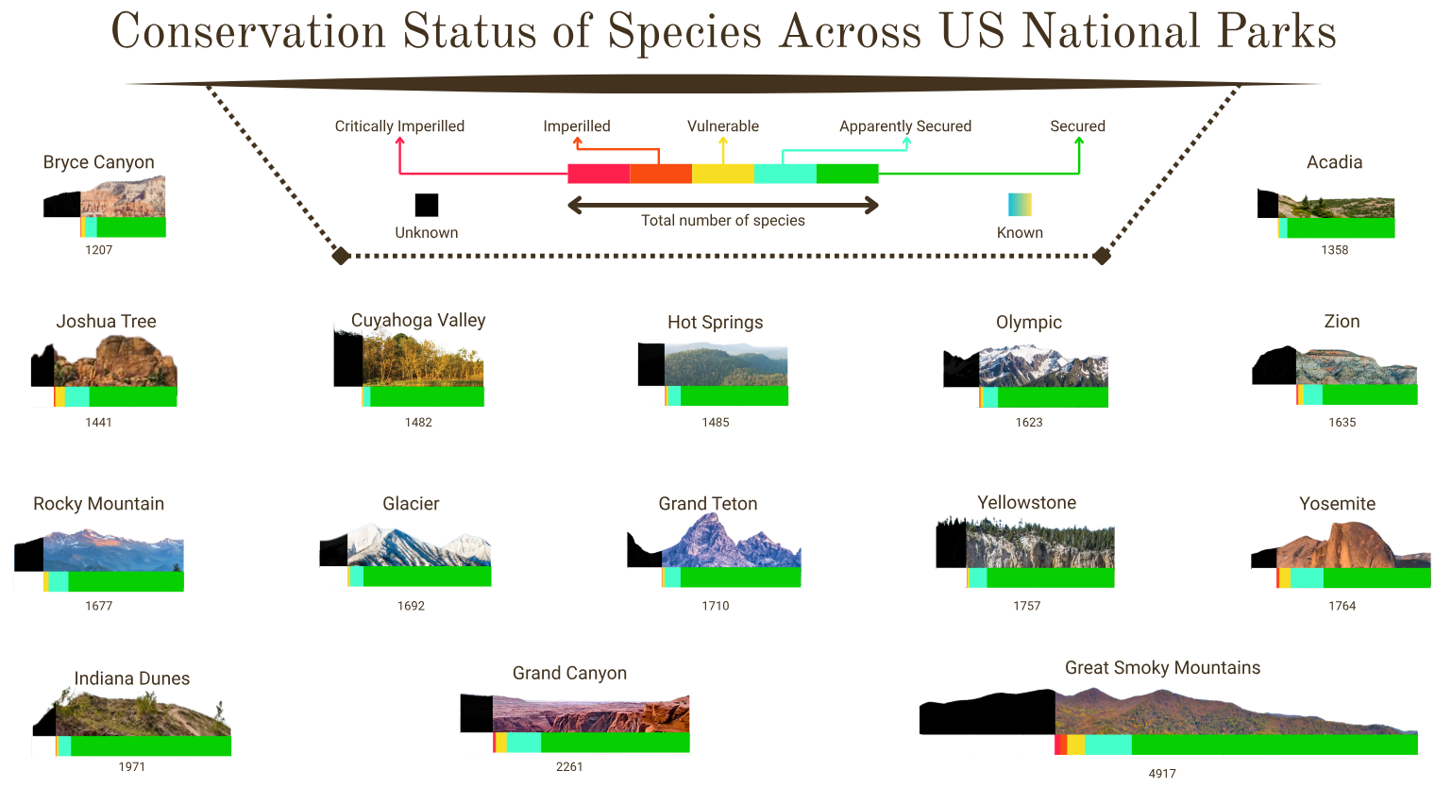

Slide 6
Q2. How are species distributed across national parks by category? (park name, species category, species count)?
Steps:
A Mapping is set up to group the many possible Category Name tags into five broad categories: Vertebrates, Invertebrates, Plants, Fungi, and Microorganisms. The program applies this mapping so that the rows now contain only one of those five large groupings.Then we make sure that every species has a single occurrence per park so that the integrity of the data is maintained.
Bubble Plot: Every national park will be represented as a bubble, with species count as the overall bubble size. The ratio of each pie chart slice to represent different categories of species will be indicated through the pie chart slices. The bubble plot setting is ideal for this examination because it allows us to represent multiple dimensions of data at once: the total species richness (bubble size), the relative distribution among categories (pie slices), and the comparison among all parks (bubble configuration).

Slide 7
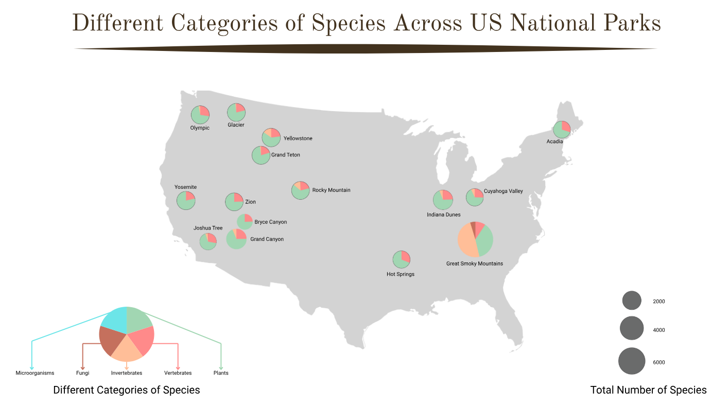

Slide 8
Some Conclusions
Great Smoky Mountains National Park has the highest species count, with a notable mix of conservation statuses
The second plot indicates that some parks, such as the Great Smoky Mountains and Grand Canyon, have a much higher species count than others.
Several parks, including Grand Canyon and Great Smoky Mountains, show a significant portion of species with unknown conservation status.
The Great Smoky Mountains appears to have the most balanced diversity, while other parks show variations in dominant species groups.
The number of species appears to correlate with park size and ecological diversity, as seen in parks like Great Smoky Mountains, Grand Canyon, and Yellowstone.

Slide 9
Q & A ?

